Slide 1
Cloud computing MODULE 2

Slide 2

Part 1
CLOUD COMPUTING ARCHITECTURE

Slide 3
CLOUD COMPUTING ARCHITECTURE
SYLLABUS : Cloud Computing Architecture, Introduction, Cloud Reference Model, Architecture, Infrastructure / Hardware as a Service, Platform as a Service, Software as a Service, Types of Clouds, Public Clouds, Private Clouds, Hybrid Clouds, Community Clouds, Economics of the Cloud, Open Challenges, Cloud Definition, Cloud Interoperability and Standards Scalability and Fault Tolerance Security, Trust, and Privacy Organizational Aspects

Slide 4
CLOUD COMPUTING SERVICES CLASSIFICATIONS
Utility oriented data centers are the first outcome of cloud computing and they serve as infrastructure through which services are implemented and delivered.
Cloud computing is a utility oriented and internet centric way of delivering IT services on demand.
These services cover the entire computing stack: from the hardware infrastructure packaged as a set of virtual machines to software services such as development platforms and distributed applications.

Slide 5
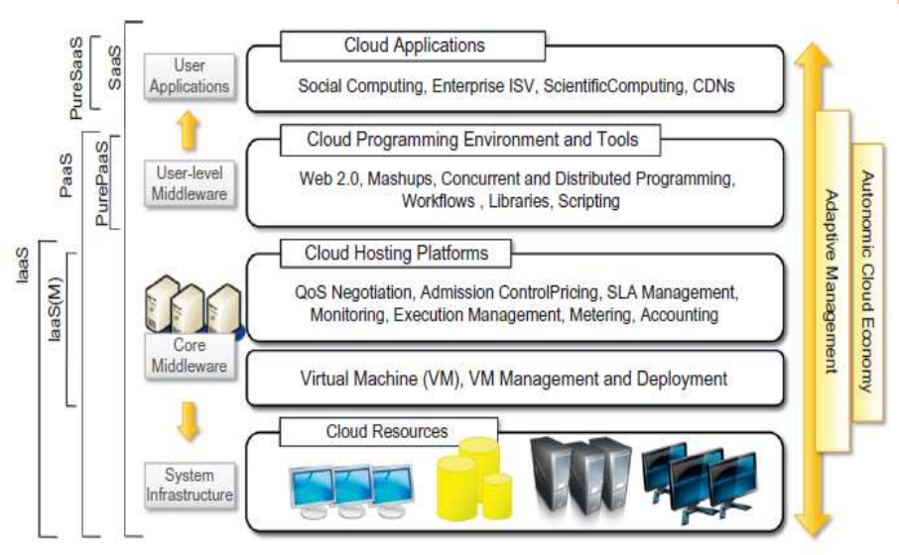
CLOUD REFERENCE MODEL - ARCHITECTURE

Slide 6
CLOUD REFERENCE MODEL - ARCHITECTURE
Cloud Resource layer is implemented using a datacenter in which hundreds and thousands of nodes are stacked together. -System Infrastructure
Cloud infrastructure can be heterogeneous in nature because a variety of resources, such as clusters and even networked PCs, can be used to build it.
The physical infrastructure is managed by the core middleware, the objectives of which are to provide an appropriate runtime environment for applications and to best utilize resources.

Slide 7
CLOUD REFERENCE MODEL - ARCHITECTURE
At the bottom of the stack, virtualization technologies are used to guarantee runtime environment customization, application isolation, sandboxing, and quality of service. Hardware virtualization is most commonly used at this level.
Hypervisors manage the pool of resources and expose the distributed infrastructure as a collection of virtual machines.
The combination of cloud hosting platforms and resources is generally classified as a Infrastructure as-a-Service (IaaS) solution.

Slide 8
CLOUD REFERENCE MODEL - ARCHITECTURE
We can organize the different examples of IaaS into two categories:
Some of them provide both the management layer and the physical infrastructure;
others provide only the management layer (IaaS (M))
Platform-as-a-Service (PaaS) : A cloud programming environments and tools, which form a new layer for offering users a development platform for applications
The range of tool includes Web-based interfaces, command-line tools, and frameworks for concurrent and distributed programming.
Pure PaaS: only the user-level middleware is offered, and it has to be complemented with a virtual or physical infrastructure.
The top layer of the reference model contains services delivered at the application level.

Slide 9
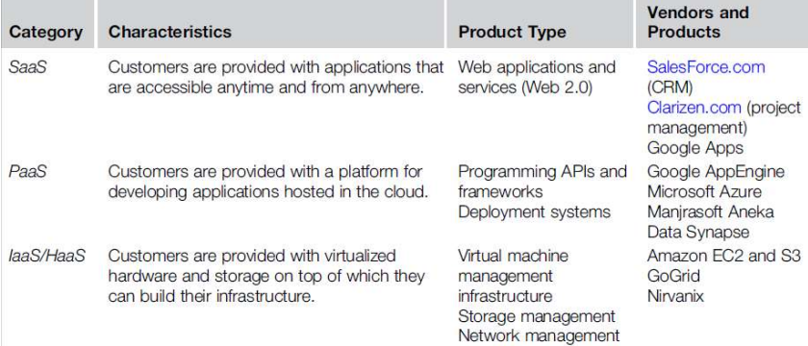
Cloud Computing Services Classification

Slide 10
INFRASTRUCTURE/HARDWARE-AS-A-SERVICE
IaaS solutions deliver customizable infrastructure on demand
IaaS offering umbrella range from single servers to entire infrastructures, including network devices, load balancers, and database and Web servers
The main technology used to deliver and implement these solutions is hardware virtualization
Virtual machines are configured and deployed and priced according to the specific features of the virtual hardware: memory, no. of processors & disk storage.
From the perspective of the service provider, IaaS/HaaS allows better exploiting the IT infrastructure
From the perspective of the customer it reduces the administration and maintenance cost as well as the capital costs allocated to purchase hardware

Slide 11
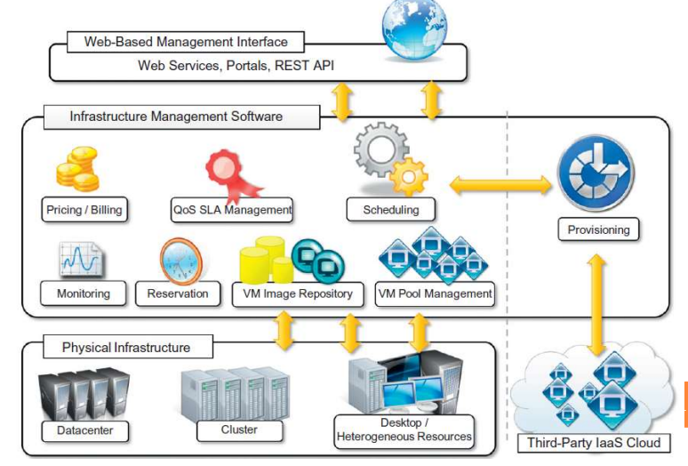
INFRASTRUCTURE-AS-A-SERVICE REFERENCE IMPLEMENTATION

Slide 12
IAAS SOLUTION-THREE PRINCIPAL LAYERS
The user interface: At the top layer the user interface provides access to the services exposed by the software management infrastructure
The software management infrastructure:
Scheduler which is in-charge of allocating the execution of virtual machine instances
The pricing and billing component takes care of the cost of executing each virtual machine instance and maintains data that will be used to charge the user
The monitoring component tracks the execution of each virtual machine instance and maintains data required for reporting and analyzing the performance of the system.
The reservation component stores the information of all the virtual machine instances that have been executed or that will be executed in the future.

Slide 13
IAAS SOLUTION-THREE PRINCIPAL LAYERS
QoS/SLA management component will maintain a repository of all the SLAs made with the users; together with the monitoring component, this component is used to ensure that a given VM instance is executed with the desired QoS.
The VM repository component provides a catalog of VM images that users can use to create virtual instances.
A VM pool manager component is responsible for keeping track of all the live instances.
Provisioning component interacts with the scheduler to provide a virtual machine instance that is external to the local physical infrastructure

Slide 14
IAAS SOLUTION-THREE PRINCIPAL LAYERS
The bottom layer is composed of the physical infrastructure, on top of which the management layer operates.
A service provider will use a massive datacenter containing hundreds or thousands of nodes.
Aggregation of Heterogeneous resources is another option - PCs, workstations, and clusters
In the case of complete IaaS solutions, all three levels are offered as service

Slide 15
IAAS SOLUTION-THREE PRINCIPAL LAYERS
Public clouds vendors such as Amazon, GoGrid, Joyent, Rightscale, Terremark, Rackspace, ElasticHosts, and Flexiscale- own large datacenters & give access to their computing infrastructures (Complete IaaS Solution)
Other solutions may cover only the user interface and the infrastructure software management layers.
They need to provide credentials to access third-party IaaS providers or to own a private infrastructure in which the management software is installed -Enomaly, Elastra, Eucalyptus, OpenNebula, VMware, IBM, and Microsoft

Slide 16
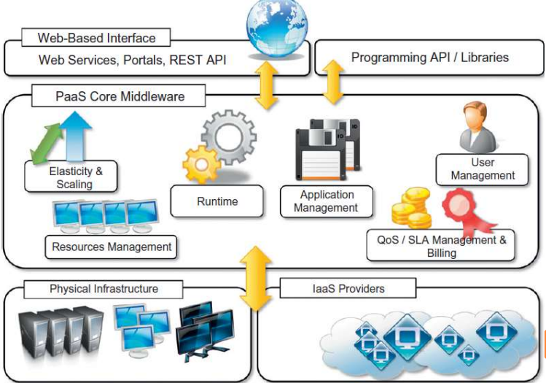
PLATFORM AS A SERVICE REFERENCE MODEL

Slide 17
PLATFORM AS A SERVICE REFERENCE MODEL
Platform-as-a-Service (PaaS) solutions provide a development and deployment platform for running applications in the cloud.- comprise the middleware.
PaaS implementations provide applications with a runtime environment and do not expose any service for managing the underlying infrastructure.
They automate the process of deploying applications to the infrastructure, configuring application components, provisioning and configuring supporting technologies such as load balancers and databases.
Developers design their systems in terms of applications and are not concerned with hardware, operating systems, and other low-level services.
The core middleware is in charge of managing the resources and scaling applications on demand or automatically based on commitments made with users.
From a user point of view, the core middleware exposes interfaces that allow programming and deploying applications on the cloud.(API’s and Libraries)
It is possible to find integrated developed environments based on 4GL and visual programming concepts, or rapid prototyping environments.

Slide 18
PLATFORM AS A SERVICE REFERENCE MODEL
Other implementations of the PaaS model provide a complete object model for representing an application and provide a programming language-based approach.
PaaS-I category identifies PaaS implementations that completely follow the cloud computing style for application development and deployment.
PaaS-II category solutions that are focused on providing a scalable infrastructure for Web application, developers generally use the provider’s APIs, which are built on top of industrial runtimes
PaaS-III category consists of all those solutions that provide a cloud programming platform for any kind of application

Slide 19
PLATFORM AS A SERVICE REFERENCE MODEL
some essential characteristics that identify a PaaS solution:
Runtime framework: This framework represents the “software stack” of the PaaS model. The runtime framework executes end-user code according to the policies set by the user and the provider.
Abstraction: PaaS solutions are distinguished by the higher level of abstraction that they provide. In the case of PaaS, the focus is on the applications the cloud must support.
Automation: PaaS environments automate the process of deploying applications to the infrastructure, scaling them by provisioning additional resources when needed based on SLA.
Cloud services: PaaS offerings provide developers and architects with services and APIs, helping them to simplify the creation and delivery of elastic and highly available cloud applications.

Slide 20
SOFTWARE AS A SERVICE
Software-as-a-Service (SaaS) is a software delivery model that provides access to applications through the Internet as a Web-based service.
It provides a means to free users from complex hardware and software management by offloading such tasks to third parties, which build applications accessible to multiple users through a Web browser.
customers neither need install anything on their premises nor have to pay considerable up-front costs to purchase the software and the required licenses
SaaS as a “one-to-many” software delivery model, whereby an application is shared across multiple users
Multitenancy, optimizing resources by sharing the costs

Slide 21
According to Software Information & Industry Association (SIIA)
In the software as a service model, the application, or service, is deployed from a centralized datacenter across a network— Internet, Intranet, LAN, or VPN—providing access and use on a recurring fee basis.
Users “rent,” “subscribe to,” “are assigned,” or “are granted access to” the applications from a central provider. Business models vary according to the level to which the software is streamlined, to lower price and increase efficiency, or value-added through customization to further improve digitized business processes.

Slide 22
Core characteristics of SaaS for ASP
The products sold to customer is application access
The application is centrally managed
The service delivered is one-to-many
The service delivered is an integrated solution delivered on the contract, which means provided as promised.
Benefits:
Software cost reduction, service level improvements
Rapid implementation
Stand alone and configurable applications
Rudimentary applications and data integration
Subscription and pay-as-you-go pricing

Slide 23
SOFTWARE AS A SERVICE
Transition into Saas 2.0
Focused on more robust infrastructure and application platform.
Changes in software eco system.
Can serve different needs – CRM, ERP and social networking.
Third party applications enriched the value of extensible and customizable.
SaaS applications – Social networking applications like Faceboof, Linkedin etc.
Office automation applications.
Integration of third party services and sharing of information with others.

Slide 24
TYPES OF CLOUDS
Public clouds: The cloud is open to the wider public.
Private clouds: The cloud is implemented within the private premises of an institution and generally made accessible to the members of the institution or a subset of them.
Hybrid or heterogeneous clouds: The cloud is a combination of the two previous solutions and most likely identifies a private cloud that has been augmented with resources or services hosted in a public cloud.
Community clouds: The cloud is characterized by a multi-administrative domain involving different deployment models (public, private, and hybrid), and it is specifically designed to address the needs of a specific industry.

Slide 25
PUBLIC CLOUD
They are a realization of canonical view of cloud computing where services offered are made available to anyone, from anywhere and any time through internet.
Structural point of view- distributed systems
Customer can sign-in with provider, enter credentials
Offers solution for minimizing IT infrastructure cost and serves for handling peak load
Ability to grow and shrink as per need i.e upsize or downsize
Multitenancy, QoS management, bill as per contract
Services – infrastructure, platform or applications
Composed by geographically dispersed data centers for load balancing, servicing better as per their location.
Drawback: Loss of control, security breaches

Slide 26
PRIVATE CLOUD
Infrastructure implemented within a private premises and able to deliver IT services only to authorized members.
Private clouds are virtual distributed systems that rely on a private infrastructure and provide internal users with dynamic provisioning of computing resources.
Key advantages of using a private cloud computing infrastructure:
Customer information protection
Infrastructure ensuring SLAs
Compliance with standard procedures and operations: If organizations are subject to third-party compliance standards, specific procedures have to be put in place when deploying and executing applications.
Private clouds can be implemented on more heterogeneous hardware: rely on existing IT infrastructure.

Slide 27
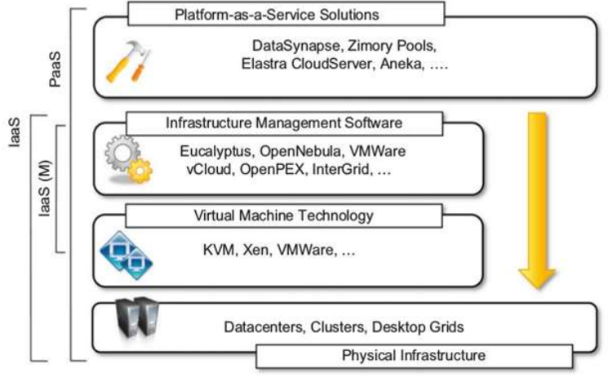
Comprehensive view of solutions – private cloud hardware and software stack is shown below

Slide 28
HYBRID CLOUD
A cloud that takes advantage of both public/private clouds that has led to development and diffusion of hybrid cloud.
It allows exploiting existing IT infrastructure, sensitive information maintenance within the premises.
Naturally growing and shrinking by provisioning external resources and releasing them when needed.
Security concerns are limited to the public portion of the cloud.
Heterogeneous system can result from a private cloud that integrates additional resources or services from one or more public cloud.
Hybrid cloud in general applies to IT infrastructure rather than software services.
Hybrid clouds address scalability issues by leveraging external resources for exceeding capacity demand. These resources or services are temporarily leased for the time required and then released. This practice is also known as cloudbursting.

Slide 29
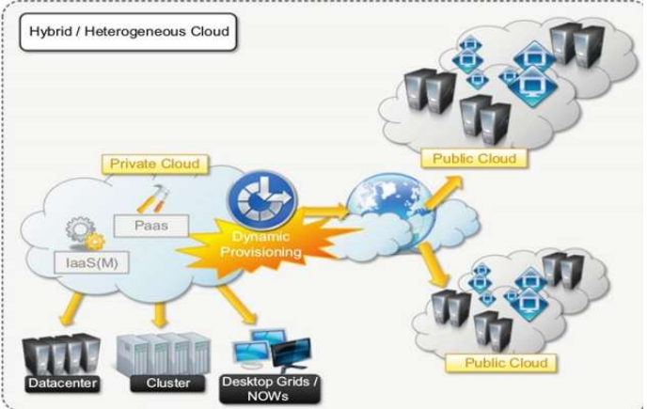
HYBRID CLOUD

Slide 30
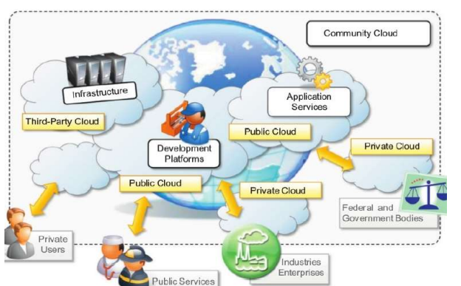
COMMUNITY CLOUDS
According to NIST “The infrastructure is shared by several organizations and supports a specific community that has shared concerns (e.g., mission, security requirements, policy, and compliance considerations). It may be managed by the organizations or a third party and may exist on premise or off premise.”

Slide 31
COMMUNITY CLOUDS
Candidate sectors for community clouds are as follows:
Media industry - looking for low-cost, agile, and simple solutions to improve the efficiency of content production
Healthcare industry: community clouds can provide a global platform on which to share information and knowledge without revealing sensitive data maintained within the private infrastructure
Energy and other core industries - community clouds can bundle the comprehensive set of solutions that together vertically address management, deployment, and orchestration of services and operations
Public sector - governmental processes involve several institutions and agencies and are aimed at providing strategic solutions at local, national, and international administrative levels
Scientific research - the common interest driving different organizations sharing a large distributed infrastructure is scientific computing

Slide 32
ECONOMICS OF THE CLOUD
Drivers of cloud computing - economy of scale and simplicity of software delivery and its operation.
Reducing the capital costs associated to the IT infrastructure
Eliminating the depreciation or lifetime costs associated with IT capital assets
Replacing software licensing with subscriptions
Cutting the maintenance and administrative costs of IT resources.
The amount of cost saving by cloud computing within an enterprise is possible with IT infrastructure, software development, CRM and ERP

Slide 33
ECONOMICS OF THE CLOUD
Three different strategies for pricing modeling :
Tiered pricing: Cloud services are offered in several tiers, each offers a fixed computing specification and SLA at a specific price per unit of time. This model is used by Amazon for pricing the EC2 service.
Per-unit pricing: It is more suitable for principal source of revenue for the cloud provider is determined in terms of units of specific services. GoGrid makes customers pay according to RAM/hour units for the servers deployed in the GoGrid cloud.
Subscription-based pricing: This is used by SaaS providers in which users pay a periodic subscription fee for use of the software or the specific component services that are integrated in their applications.

Slide 34
OPEN CHALLENGES IN CLOUD
Cloud definition
NIST, XaaS Concept
Cloud interoperability and standards
Vendor lockin
Cloud Computing Interoperability Forum, Open Cloud Consortium, Open Virtualization format
Scalability and fault tolerance
Scaling beyond in-house limits
Security, trust, and privacy
Organizational aspects
New role of IT dept
How to get compliance
Implication(Political, legal) –lose control
Perception of end users

Slide 35
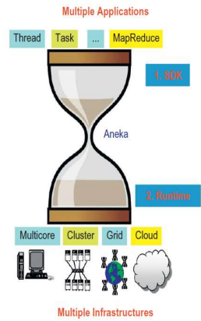
ANEKA-CLOUD APPLICATION PLATFORM
Aneka is Manjrasoft’s solution for developing, deploying, and managing cloud applications.
Aneka consists of as scalable cloud middleware that can be deployed on top of heterogeneous computing resources.
offers an extensible collection of services coordinating the execution of applications, helping administrators monitor the status of the cloud, and providing integration with existing cloud technologies.
key advantages is its extensible set of application programming interfaces (APIs) associated with different types of programming models—such as Task, Thread, and MapReduce used for developing distributed applications

Slide 36
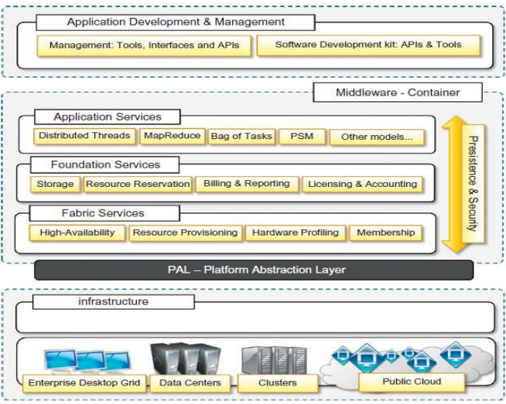
Aneka framework

Slide 37
ANEKA-CLOUD APPLICATION PLATFORM
Aneka is a cloud middleware product that can be deployed on a heterogeneous set of resources: a network of computers, a multicore server, datacenters, virtual cloud infrastructures, or a mixture of these --- Pure SaaS
The core infrastructure of the system provides a uniform layer that allows the framework to be deployed over different platforms and operating systems.
The physical and virtual resources representing the bare metal of the cloud are managed by the Aneka container, which is installed on each node and constitutes the basic building block of the middleware.
A collection of interconnected containers constitute the Aneka Cloud: a single domain in which services are made available to users and developers.
The container features three different classes of services: Fabric Services, Foundation Services, Execution Services

Slide 38
ANEKA-CLOUD APPLICATION PLATFORM
Aneka implements a service-oriented architecture
Services operate at container level and provide developers, users, and administrators with all features offered by the framework.
The infrastructure allows for the integration of new services or replacement of the existing ones with a different implementation.
The framework includes the basic services for infrastructure and node management, application execution, accounting, and system monitoring.
A programming model represents a collection of abstractions that developers can use to express distributed applications + the runtime support for a programming model

Slide 39
Services involved in Aneka Cloud environment
Elasticity and scaling: dynamically upsizing and downsizing of the infrastructure available for applications
Runtime management: The runtime machinery is responsible for keeping the infrastructure up and running and serves as a hosting environment for services
Resource management: Provides capabilities for reserving nodes for exclusive use by specific applications
Application management: services include scheduling, execution, monitoring, and storage management
User management: to define users, groups, and permissions
QoS/SLA management and billing

Slide 40
ANATOMY OF THE ANEKA CONTAINER
The Aneka container represents the runtime machinery available to services and applications
The container, the unit of deployment in Aneka Clouds, is a lightweight software layer designed to host services and interact with the underlying operating system and hardware.
Role of the container is to provide a lightweight environment in which to deploy services and some basic capabilities such as communication channels through which it interacts with other nodes in the Aneka Cloud
The services installed in the Aneka container can be classified into three major categories:
Fabric Services
Foundation Services
Application Services

Slide 41
ANATOMY OF THE ANEKA CONTAINER
Services stack resides on top of the Platform Abstraction Layer(PAL), representing the interface to the underlying operating system and hardware
It provides a uniform view of the software and hardware environment in which the container is running
System is based on the .NET technology and allows the Aneka container to be portable over different platforms and operating systems.
Any platform featuring an ECMA-334 and ECMA-335 compatible environment can host and run an instance of the Aneka container
The Common Language Infrastructure(CLI), which is the specification introduced in the ECMA-334 standard, defines a common runtime environment and application model for executing programs

Slide 42
ANATOMY OF THE ANEKA CONTAINER
The Platform Abstraction Layer(PAL) addresses heterogeneity and provides the container with a uniform interface for accessing the relevant hardware and operating system information
The PAL is responsible for detecting the supported hosting environment and providing the corresponding implementation to interact with it to support the activity of the container
Features of PAL
Uniform and platform-independent implementation interface for accessing the hosting platform
Uniform access to extended and additional properties of the hosting platform
Uniform and platform-independent access to remote nodes
Uniform and platform-independent management interfaces

Slide 43
ANATOMY OF THE ANEKA CONTAINER
The PAL is a small layer of software that comprises a detection engine, which automatically configures the container at boot time, with the platform-specific component to access the information and an implementation of the abstraction layer for the Windows, Linux, and Mac OS X operating systems
The collectible data that are exposed by the PAL
Number of cores, frequency, and CPU usage
Memory size and usage
Aggregate available disk space
Network addresses and devices attached to the node

Slide 44
FABRIC SERVICES
Fabric services provide access to the resourceprovisioning subsystem and to the monitoring facilities implemented in Aneka
Profiling and monitoring
Heartbeat,
Monitoring, and Reporting Services
Resource management
Index Service (or Membership Catalogue),
Reservation Service
Resource Provisioning Service.

Slide 45
HEARTBEAT SERVICE
The Heartbeat Service periodically collects the dynamic performance information about the node and publishes this information to the membership service in the Aneka Cloud.
Data collected by the index node of the Cloud, which makes them available for services such as reservations and scheduling in order to optimize the use of a heterogeneous infrastructure
Basic information about memory, disk space, CPU, and operating system is collected
Additional data are pulled into the “alive” message, such as information about the installed software in the system and any other useful information
A specific component, called Node Resolver, is in charge of collecting these data and making them available to the Heartbeat Service

Slide 46
HEARTBEAT SERVICE
The Reporting Service manages the store for monitored data and makes them accessible to other services or external applications for analysis purposes
Built-in services which provide information about monitoring and profiling
The Membership Catalogue tracks the performance information of nodes
The Execution Service monitors several time intervals for the execution of jobs
The Scheduling Service tracks the state transitions of jobs
The Storage Service monitors and makes available information about data transfer, such as upload and download times, filenames, and sizes
The Resource Provisioning Service tracks the provisioning and lifetime information of virtual nodes

Slide 47
RESOURCE MANAGEMENT
Comprises tasks: resource membership, resource reservation, and resource provisioning
Resource management Services
Index Service (or Membership Catalogue)
Reservation Service
Resource Provisioning Service.
The Membership Catalogue
keeps track of the basic node information for all the nodes that are connected or disconnected
implements the basic services of a directory service, allowing the search for services using attributes such as names and nodes
each instance publishes its information , and updates it constantly during its lifetime

Slide 48
RESOURCE MANAGEMENT
Resource Provisioning Service
includes all the operations that are needed for provisioning virtual instances (resource pooling)
support QoS requirements-driven execution of applications
serves requests coming from the Reservation Service or the Scheduling Services
Reservation Service
helps to stores the information of all the virtual machine instances that have been executed or that will be executed in the future.

Slide 49
FOUNDATION SERVICES
Related to the logical management of the distributed system built on top of the infrastructure
provide supporting services for the execution of distributed applications
provide a uniform approach to managing distributed applications
Foundation services includes
Storage management for applications
Accounting, billing, and resource pricing
Resource reservation

Slide 50
Storage management
Aneka offers two different facilities for storage management:
A centralized file storage
execution of compute intensive applications
Require powerful processors and do not have high demands in terms of storage
Aneka’s Storage Service –provides distributed applications with the basic file transfer facility (Normal FTP)
File channel uses the components file channel controller and handler to upload, download and browse files
Distributed file system
Storage support for data-intensive applications
Google File System used as a reference, maser node based
keeps track of the status of all the storage nodes,
A pool of chunk servers, which provide distributed storage space in which to store files
Files are logically organized into a directory structure

Slide 51
Storage management
Characteristics Google File System
Files are huge by traditional standards (multi-gigabytes).
Files are modified by appending new data rather than rewriting existing data.
There are two kinds of major workloads: large streaming reads and small random reads.
It is more important to have a sustained bandwidth than a low latency

Slide 52
Accounting, billing, and resource pricing
Accounting Services keep track of the status of applications in the Aneka Cloud
Detailed breakdown of usage is vital for proper management of resources
Complete history of application execution, storage and other resource utilization parameters is captured
Aneka Billing Service provides detailed information about each user’s usage of resources, with the associated costs
Resources are priced differently as per the available set of services.

Slide 53
Resource reservation
Aneka’s Resource reservation supports the execution of distributed applications and allows for reserving resources for exclusive use by specific applications
Supports two different kinds of services:
Resource Reservation : keeps track of all the reserved time slots in the Aneka Cloud and provides a unified view of the system.
The Allocation Service: is installed on each node that features execution services and manages the database of information regarding the allocated slots on the local node.
Applications that need to complete within a given deadline can make a reservation request for a specific number of nodes in a given timeframe.
Later, the Reservation Service will return a reservation identifier as proof of the resource booking.

Slide 54
Aneka Framework implementations
Aneka Framework supports three different implementations:
Basic Reservation: Features the basic capability to reserve execution slots on nodes and implements the alternate offers protocol, which provides alternative options in case the initial reservation requests cannot be satisfied
Libra Reservation: Represents a variation of the previous implementation that features the ability to price nodes differently according to their hardware capabilities
Relay Reservation: Constitutes a very thin implementation that allows a resource broker to reserve nodes in Aneka Clouds and control the logic with which these nodes are reserved (integration scenarios )

Slide 55
Aneka Framework implementations
Manage the execution of applications and constitute a layer that differentiates based on specific model used
Two major types of activities that are common across all the supported models:
Scheduling
Execution
Scheduling Services are in-charge of planning the execution of distributed applications and governing the allocation of jobs
Constitute the integration point with several other Foundation and Fabric Services
Scheduling components common tasks performed are
Job to node mapping, Rescheduling of failed jobs
Job status monitoring and Application status monitoring

Slide 56
Aneka Framework implementations
Execution Services
Control the execution of single jobs that compose applns.
In-charge of setting up the runtime environment hosting the execution of jobs
Common operations that apply across all the range of supported models:
Unpacking the jobs received from the scheduler
Retrieval of input files required for job execution
Sandboxed execution of jobs
Submission of output files at the end of execution
Execution failure management
Performance monitoring
Packing jobs and sending them back to the scheduler
Supporting models – Task model, Thread model, MapReduce Model and Parameter sweep model

Slide 57
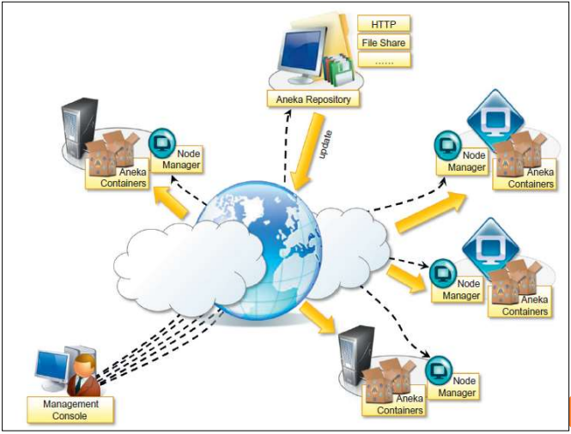
BUILDING ANEKA CLOUDS - INFRASTRUCTURE ORGANIZATION

Slide 58
BUILDING ANEKA CLOUDS - INFRASTRUCTURE ORGANIZATION
Administrative Console, which performs all the required management operations
Fundamental element for Aneka Cloud deployment is constituted by repositories
Repository provides storage for all the libraries required to layout and install the basic Aneka platform
These libraries constitute the software image for the node manager and the container programs
Management Console can manage multiple repositories and select the one that best suits the specific deployment
Aneka node manager(Aneka daemon) constitutes the remote management service used to deploy and control container instances

Slide 59
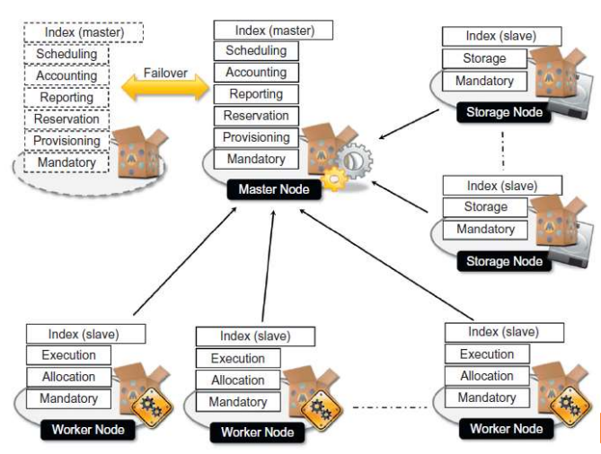
Logical organization of Aneka Clouds

Slide 60
Logical organization of Aneka Clouds
The logical organization of Aneka Clouds is depends on the configuration selected for each of the container instances
Common scenario is to use a master-worker configuration
The master node features all the services that are most likely to be present in one single copy and that provide the intelligence of the Aneka Cloud Index Service (master copy)
Configuration of the master node
Heartbeat Service
Logging Service
Reservation Service
Resource Provisioning Service
Accounting Service
Reporting and Monitoring Service
Scheduling Services for the supported programming models

Slide 61
Logical organization of Aneka Clouds
The master node also provides connection to an RDBMS facility where the state of several services is maintained
The worker nodes constitute the workforce of Aneka Cloud & are generally configured for Applications execution.
A very common configuration of is the following:
Index Service, Heartbeat Service, Logging Service, Allocation Service, Monitoring Service, Execution Services for the supported programming models
Storage nodes are optimized to provide storage support to applications
The number of storage nodes strictly depends on the predicted workload and storage consumption of applications
The common configuration of a storage node is the following:
Index Service, Heartbeat Service , Logging Service, Monitoring Service, Storage Service

Slide 62
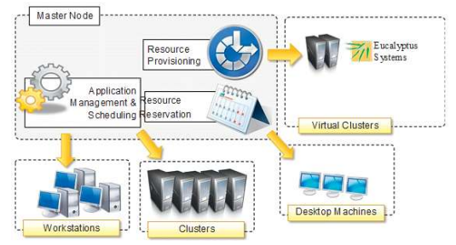
PRIVATE CLOUD DEPLOYMENT MODE
Constituted by local physical and infrastructure management software that provide access
Aneka clouds are created by exploiting a heterogeneous pool of resources
Configuration is done to leverage the resources as per the applications need
Resource provisioning service integrate virtual nodes.

Slide 63
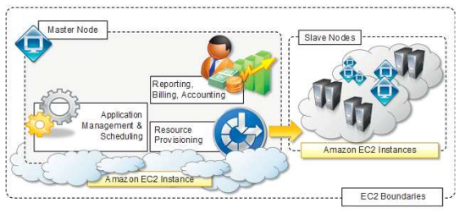
PUBLIC CLOUD DEPLOYMENT MODE
Features the installation of Aneka master and worker nodes over a completely virtualized infrastructure hosted on one or more resource providers.
Replicates classic Aneka installation on a physical infrastructure without any dynamic provisioning capability.
Deployment is generally contained within the infrastructure boundaries of a single Iaas providers.

Slide 64
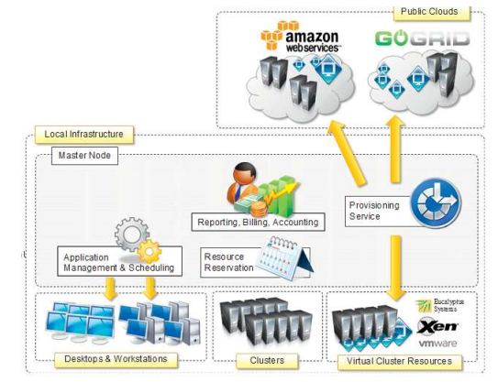
HYBRID CLOUD DEPLOYMENT MODE
Existing computing infrastructure leveraged to address the computing needs of applications.
All the capabilities of framework are able to leverage.

Slide 65
CLOUD PROGRAMMING AND MANAGEMENT - ANEKA SDK
Aneka provides APIs for developing applications on top of various programming models
SDK provides support for both programming models and services by means of
Application Model :covers the development of applications and new programming models
Service Model: defines the general infrastructure for service development

Slide 66
Application Model
The Application Model represents the minimum set of APIs that is common to all the programming models for representing and programming distributed applications on top of Aneka
Each distributed application running on top of Aneka is an instance of the Application Base class, where M identifies the specific type of application manager used to control the application
Application classes constitute the developers’ view of a distributed application on Aneka Clouds
Application managers are internal components that interact with Aneka Clouds in order to monitor and control the execution
Aneka further specializes applications into two main categories:
(1) applications whose tasks are generated by the user( Task Thread and Parameter Sweep Model)
(2) applications whose tasks are generated by the runtime infrastructure (MapReduce )

Slide 67
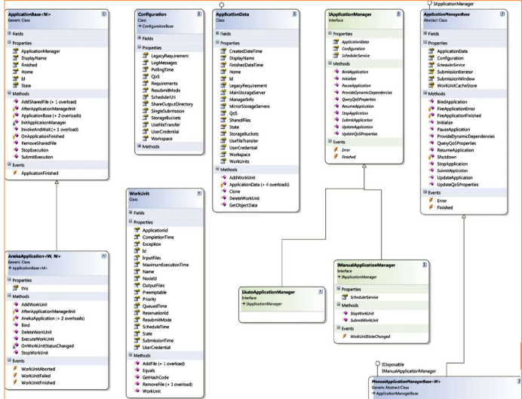

Slide 68
SERVICE MODEL
It defines the basic requirements needed to implement a service hosted in the Aneka cloud and that expose the following properties –
Name and status, control operations, message handling by means of handlemessage method
Special services also help clients by direct interaction.
Service life cycle reference describes each service instance within Aneka container.
Shaded balloon – transient state, white – steady state
Once container is started that iteratively call the start method on each service method.
Running state – active and running
Pause , Resume, continue, stop finally shut down.

Slide 69
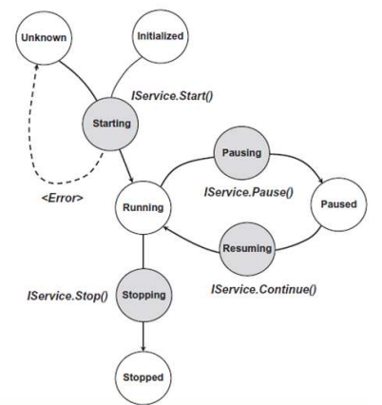
life cycle of each service instance in the Aneka container
SERVICE MODEL

Slide 70
MANAGEMENT TOOLS
Infrastructure Management: Virtual hardware by Resource provisioning and physical hardware by Administrative console.
Platform Management: a collection of connected containers define the platform on top of which applications are executed. Features available for platform management are concerned with logical organization and structure.
Application Management : applications identifies the user contributions the cloud. Management API provides administrators with monitoring and profiling features

